Slide 1
NETCONF
Gnanavel Krishnan
Jan 2018

Slide 2
NETCONF
Table of Contents
Motivation for NETCONF
Network Operator requirements captured in RFC 3535
Implications of transactional management
NETCONF Overview
NETCONF RPC Messages
NETCONF Operations

Slide 3
NETCONF
Motivation for NETCONF
Ease of use is a key requirement for any network management technology
clear distinction between configuration data and operational data
It is required to be able to fetch separately configuration data, operational state data, and statistics from devices

Slide 4
NETCONF
Motivation for NETCONF
It is necessary to enable operators to concentrate on the configuration of the network as a whole rather than individual devices.
Support for configuration transactions across a number of devices would significantly simplify network configuration management.
. A mechanism to dump and restore configurations is a primitive operation needed by operators. Standards for pulling and pushing configurations from/to devices are desirable.
Standard protocol between OSS, NMS, EMS

Slide 5
NETCONF
NETCONF Overview
To meet operator requirements RFC# 3535 NETCONF is proposed by IETF
Robust Transaction Model
NETCONF allows a Manager set entirely new configuration in a single
<edit-config> transaction
Validation and rollback supported
Network wide transaction possible
Clear separation of configuration and operational data
get-config operation is used retrieve configuration data
get operation is used to retrieve both configuration state data

Slide 6
NETCONF
NETCONF Overview
Backup and Restore
Backup entire configuration as xml and restore configuration from xml
Multiple Datastore
running, candidate, startup datastore are supported
Advanced retrieval filtering
Sub tree Xml filter supported
xPath filter can be supported

Slide 7
NETCONF
NETCONF What is different ?
 | NETCONF | SNMP
Standard | IETF | IETF
Resources | Paths Ex: /router/interface /server/ip[key=1..2.3] | OIDs Ex: 12.2.3.4
Data Models | Yang | MIBs
Operations | get, get-config, edit-config, copy-config, delete-config, | get, get-next, get-response, set, set-response, trap
Message | <rpc>, <rpc-reply> <notification> | Set, Get, GetNext, GetBulk PDUs Trap PDU
Encoding | XML | BER
Transport | SSH/TLS | UDP

Slide 8
NETCONF
Management System Architecture
Management System
Device2
Yang modue 2
Device1
Yang module1
Netconf Client
Operations: get, get-config, edit-config
Netconf Server

Slide 9
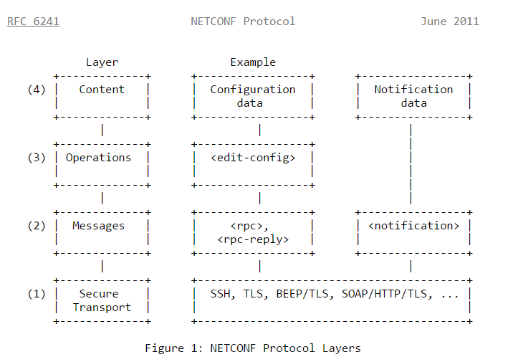
NETCONF
NETCONF Protocol Layers

Slide 10
NETCONF
NETCONF RPC Message
The NETCONF protocol uses an RPC-based communication model.
NETCONF peers use <rpc> and <rpc-reply> elements
<rpc message-id="101"xmlns="urn:ietf:params:xml:ns:netconf:base:1.0">
<my-netconf-operation xmlns="http://example.net/my-netconf/1.0">
<my-first-parameter>14</my-first-parameter>
<another-parameter>fred</another-parameter>
</my-netconf-operation>
</rpc>

Slide 11
NETCONF
NETCONF RPC Message
<rpc-reply> elements
<rpc-reply message-id="101“ xmlns="urn:ietf:params:xml:ns:netconf:base:1.0“ >
<!-- contents here... -->
</rpc-reply>

Slide 12
NETCONF
NETCONF RPC Message
rpc-error reply
<rpc-reply xmlns="urn:ietf:params:xml:ns:netconf:base:1.0">
<rpc-error>
<error-type>rpc</error-type>
<error-tag>missing-attribute</error-tag>
<error-severity>error</error-severity>
<error-info>
<bad-attribute>message-id</bad-attribute>
<bad-element>rpc</bad-element>
</error-info>
</rpc-error>
</rpc-reply>

Slide 13
NETCONF
Netconf Operations
NETCONF Operations
get
get-config
edit-config
Copy-config
delete-config
Notification events
Events are reported as notification Netconf client
Custom RPC can be defined with Yang

Slide 14
NETCONF
Netconf Hello Message
Server Hello Message:
<?xml version="1.0" encoding="UTF-8"?>
<hello xmlns="urn:ietf:params:xml:ns:netconf:base:1.1">
<capabilities>
<capability>urn:ietf:params:netconf:base:1.1</capability>
<capability>urn:ietf:params:xml:ns:yang:ietf-inet-types?revision=2010-09-24&amp;module=ietf-inet-types</capability>
</capabilities>
</hello>
Client Hello Message:
<?xml version="1.0" encoding="UTF-8"?>
<hello xmlns="urn:ietf:params:xml:ns:netconf:base:1.1">
<capabilities>
<capability>urn:ietf:params:netconf:base:1.1</capability>
</capabilities>
</hello>

Slide 15
NETCONF
get operation
rpc get:
<rpc xmlns="urn:ietf:params:xml:ns:netconf:base:1.0“ message-id=“1" >
<get />
</rpc>
rpc-reply :
<rpc-reply xmlns="urn:ietf:params:xml:ns:netconf:base:1.0" message-id="1">
<data>
<server xmlns="urn:nokia:com:system" >
<name>smtp</name>
<ip>192.0.2.1</ip>
<port>25</port>
<operational-data>….</operational-data>
</server>
</data>
</rpc-reply>

Slide 16
NETCONF
get-config operation
rpc get-config:
<rpc xmlns="urn:ietf:params:xml:ns:netconf:base:1.0“ message-id=“1" >
<get-config >
<source> <running/> </source>
</get-config >
</rpc>
rpc-reply :
<rpc-reply xmlns="urn:ietf:params:xml:ns:netconf:base:1.0" message-id="1">
<data>
<server xmlns="urn:nokia:com:system" >
<name>smtp</name>
<ip>192.0.2.1</ip>
<port>25</port>
</server>
</data>
</rpc-reply>

Slide 17
NETCONF
Get-config with filter
rpc get-config with filter:
<rpc xmlns="urn:ietf:params:xml:ns:netconf:base:1.1” message-id="1">
<get-config>
<source>
<running/>
</source>
<filter xmlns="http://tail-f.com/ns/aaa/1.1">
<server xmlns="urn:nokia:com:system" >
<name>smtp</name>
</server>
</filter>
</get-config>
</rpc>

Slide 18
NETCONF
get-config rpc-reply
rpc-reply :
<rpc-reply xmlns="urn:ietf:params:xml:ns:netconf:base:1.0" message-id="1">
<data>
<server xmlns="urn:nokia:com:system" >
<name>smtp</name>
<ip>192.0.2.1</ip>
<port>25</port>
</server>
</data>
</rpc-reply>

Slide 19
NETCONF
edit-config operation
Rpc edit-config :
<rpc xmlns="urn:ietf:params:xml:ns:netconf:base:1.1” message-id="1">
<edit-config>
<target><running/></target>
<config>
<server xmlns="urn:nokia:com:system" xmlns:nc="urn:ietf:params:xml:ns:netconf:base:1.1”
xc:operation=“create” >
<name>ftp</name>
<ip>192.0.2.1</ip>
<port>22</port>
</server>
</config>
</edit-config>
</rpc>

Slide 20
NETCONF
edit-config reply
rpc-reply :
<rpc-reply xmlns="urn:ietf:params:xml:ns:netconf:base:1.0" message-id="1">
<ok />
</rpc-reply>

Slide 21
NETCONF
copy-config
rpc copy-config:
<rpc message-id="101” xmlns="urn:ietf:params:xml:ns:netconf:base:1.1">
<copy-config>
<target><running/></target>
<source>
<url>https://user@example.com:passphrase/cfg/server-config.xml</url>
</source>
</copy-config>
</rpc>
rpc-reply :
<rpc-reply message-id="101” xmlns="urn:ietf:params:xml:ns:netconf:base:1.1">
<ok/>
</rpc-reply>

Slide 22
NETCONF
Lock operation
rpc lock:
<rpc message-id="101” xmlns="urn:ietf:params:xml:ns:netconf:base:1.1">
<lock>
<target>
<candidate />
</target>
</lock>
</rpc>
rpc-reply :
<rpc-reply message-id="101” xmlns="urn:ietf:params:xml:ns:netconf:base:1.1">
<ok/>
</rpc-reply>

Slide 23
NETCONF
Unlock operation
rpc unlock:
<rpc message-id="101” xmlns="urn:ietf:params:xml:ns:netconf:base:1.1">
<unlock>
<target>
<candidate />
</target>
</unlock>
</rpc>
rpc-reply :
<rpc-reply message-id="101” xmlns="urn:ietf:params:xml:ns:netconf:base:1.1">
<ok/>
</rpc-reply>

Slide 24
NETCONF
Close-session operation
rpc close-session:
<rpc message-id="101” xmlns="urn:ietf:params:xml:ns:netconf:base:1.1">
<close-session />
</rpc>
rpc-reply :
<rpc-reply message-id="101” xmlns="urn:ietf:params:xml:ns:netconf:base:1.1">
<ok/>
</rpc-reply>

Slide 25
NETCONF
Kill-session operation
rpc kill-session:
<rpc message-id="101” xmlns="urn:ietf:params:xml:ns:netconf:base:1.1">
<kill-session>
<session-id>17</session-id>
</kill-session>
</rpc>
rpc-reply :
<rpc-reply message-id="101” xmlns="urn:ietf:params:xml:ns:netconf:base:1.1">
<ok/>
</rpc-reply>

Slide 26
NETCONF
delete-config operation
rpc delete-config:
<rpc message-id="101” xmlns="urn:ietf:params:xml:ns:netconf:base:1.1">
<delete-config>
<target>
<startup/>
</target>
</delete -config>
</rpc>
rpc-reply :
<rpc-reply message-id="101” xmlns="urn:ietf:params:xml:ns:netconf:base:1.1">
<ok/>
</rpc-reply>

